Slide 1

ENME605 Dynamic Modeling Project
Alex Beyer, Kaustubh Joshi

Slide 2
The Problem
y⁺
g
k₁ (N/rad)
Double Pendulum
Joint 1 is actuated with input τ₁
Joint 1 angle (θ₁) is output
Links 1 and 2 are connected by a stiff spring (k₂ = 50) to help straighten leg without a control input
Assumptions
Mass and Inertia are lumped at link end
x⁺
a₁
k₂ (N/rad)
θ₁
m₁, I₁
a₂
θ₂
m₂, I₂

Slide 3
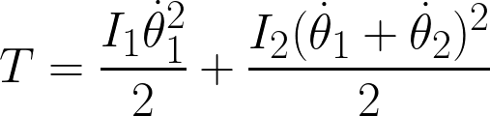
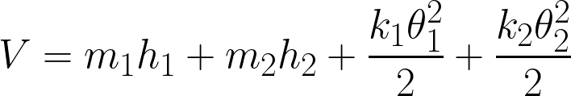
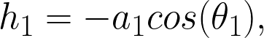
System Modeling
k₁ (N/rad)
Used a Lagrangian based approach:
Kinetic Energy
Potential Energy
a₁
k₂ (N/rad)
θ₁
m₁, I₁
a₂
θ₂
m₂, I₂

Slide 4
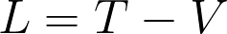
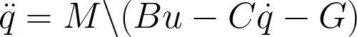
System Modeling – Manipulator Form Dynamics
Standard way to reformulate Lagrangian into equations of motion:
Inertia Matrix
Coriolis Matrix
Input Mapping
Gravity Vector

Slide 5
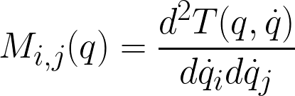
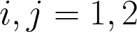
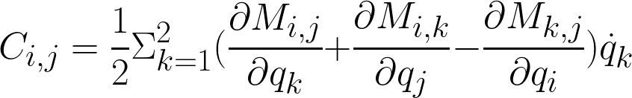
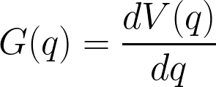
System Modeling
k₁ (N/rad)
Posed system in Manipulator form to get equations of motion:
Inertia Matrix:
Coriolis Matrix:
Gravity Vector:
a₁
k₂ (N/rad)
θ₁
m₁, I₁
a₂
θ₂
m₂, I₂

Slide 6
System Modeling
k₁ (N/rad)
Finally, used MATLAB Symbolic Math Toolbox to linearize the system:
a₁
ddx = [dq;...
M\([tau1;0] - C*dq - G)];
A2 = jacobian(ddx,x);
B2 = jacobian(ddx,tau1);
C2 = jacobian(x,x);
D2 = jacobian(x,tau1);
fprintf("System Matrices Found! \n ");
[I1,I2,m1,m2,a1,a2,k1,k2] = getVars();
tht1 = qDes(1); tht2 = qDes(2);
dtht1 = dqDes(1); dtht2 = dqDes(2);
tau1 = tauDes(1);
A2 = double(subs(A2));
B2 = double(subs(B2));
C2 = double(subs(C2));
D2 = double(subs(D2));
fprintf("System Matrix Substitution Done! \n");
save('getLinearizedSystem','A2','B2',"C2","D2")
k₂ (N/rad)
θ₁
m₁, I₁
a₂
θ₂
m₂, I₂

Slide 7
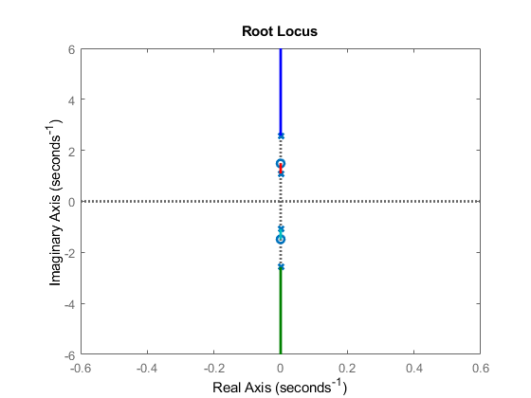
Initial Plots of System Stability – Root Locus
Plots generated using MATLAB Control Toolbox:

Slide 8
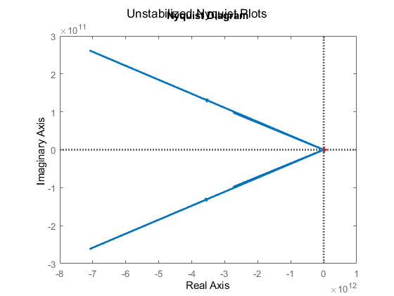
Initial Plots of System Stability – Nyquist Plot
Nyquist Diagram
Plots generated using MATLAB Control Toolbox:

Slide 9
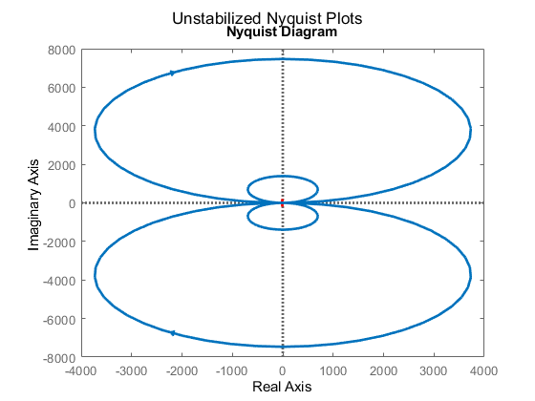
Initial Plots of System Stability – Nyquist Plot (Damped)
Plots generated using MATLAB Control Toolbox:

Slide 10
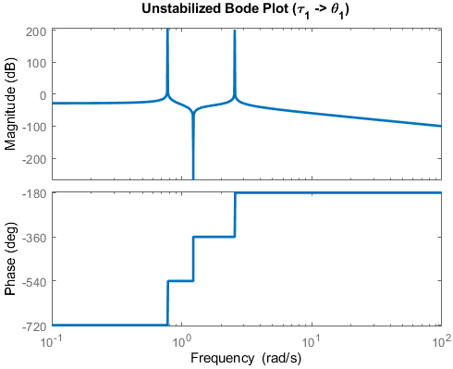
Initial Plots of System Stability – Bode Plot(s)
(2)
(1)
(3)

Slide 11
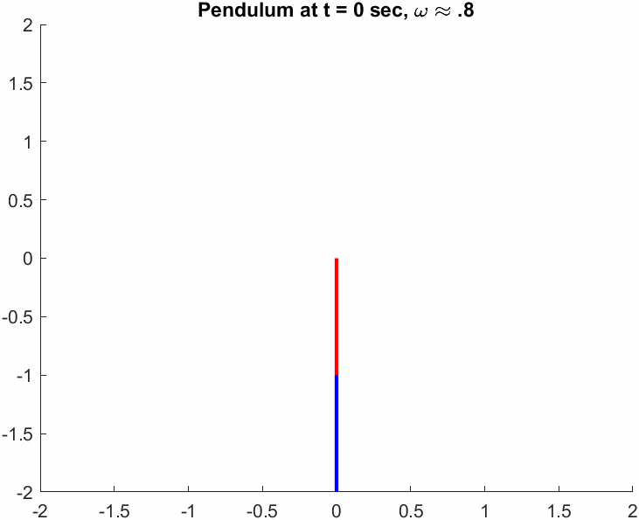
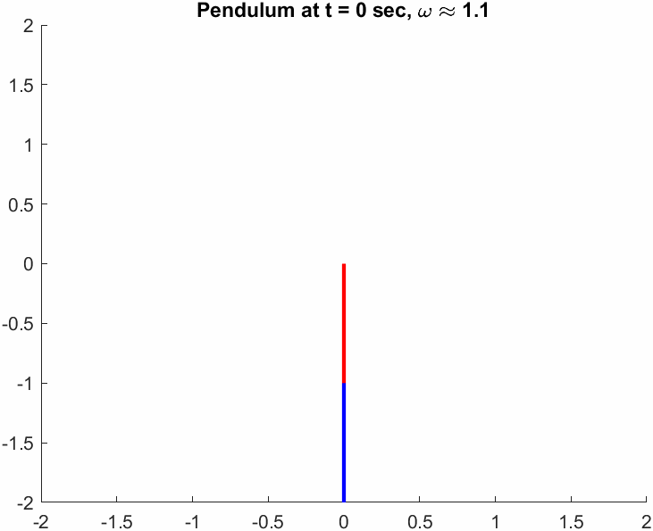
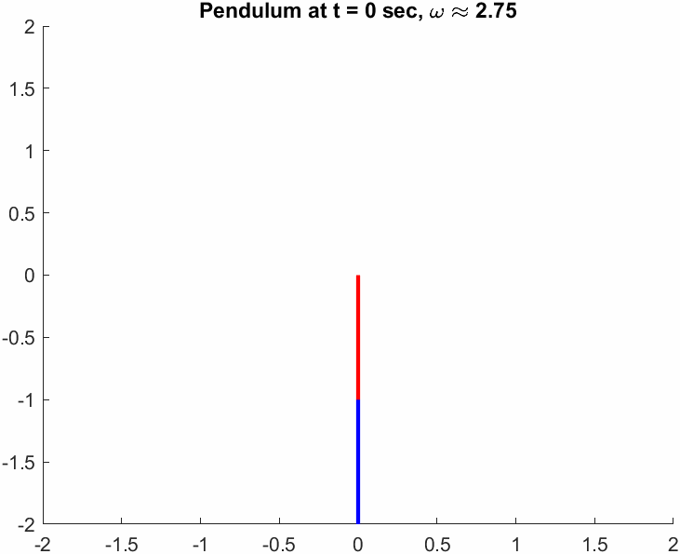
Initial Plots of System Stability – Animations at Resonance
(1)
(2)
(3)
Both members perfectly in phase
Resonance for single member pendulum(?)
Both members perfectly out of phase

Slide 12
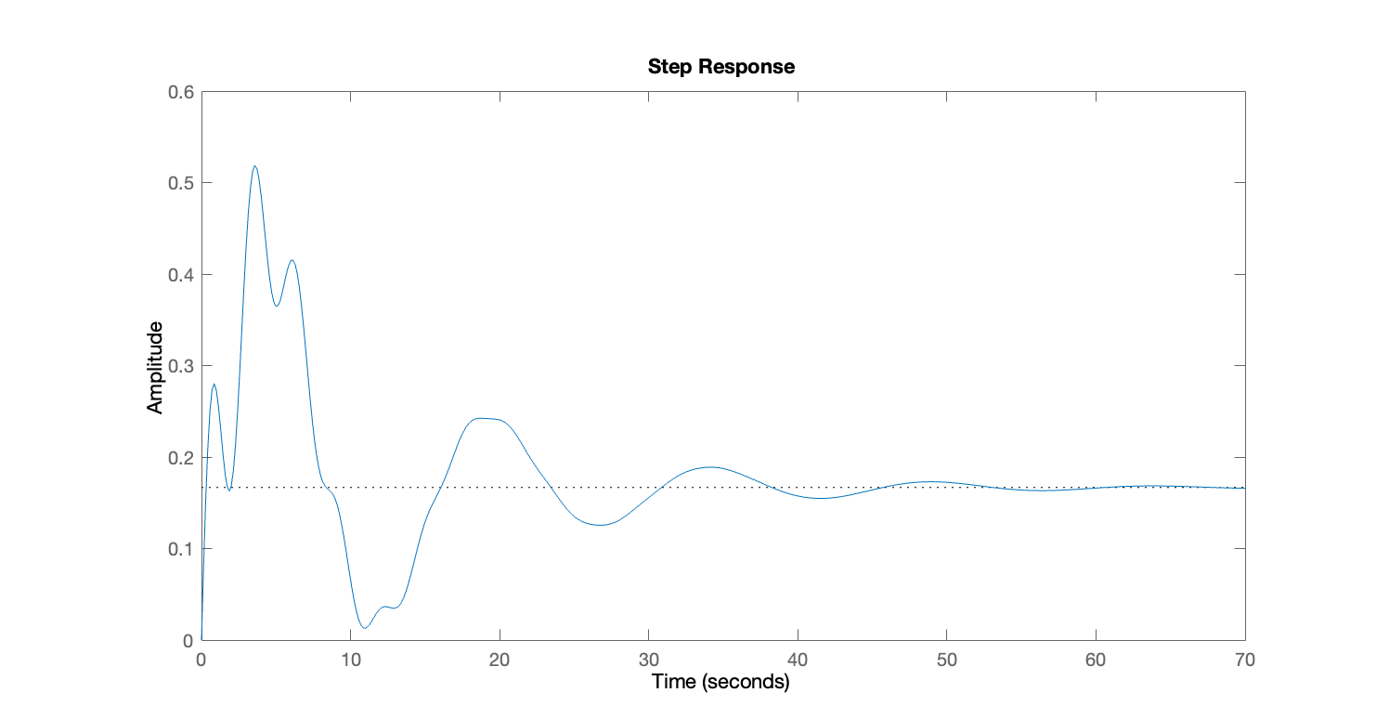
Stabilizing the System using PID
Kp = 1
Ki = 0
Kd = 6
No feedforward gain
RiseTime: 0.2492
TransientTime: 43.8255
SettlingTime: 56.7205
SettlingMin: 0.0129
SettlingMax: 0.5186
Overshoot: 211.1504
Undershoot: 0
Peak: 0.5186
PeakTime: 3.5696

Slide 13
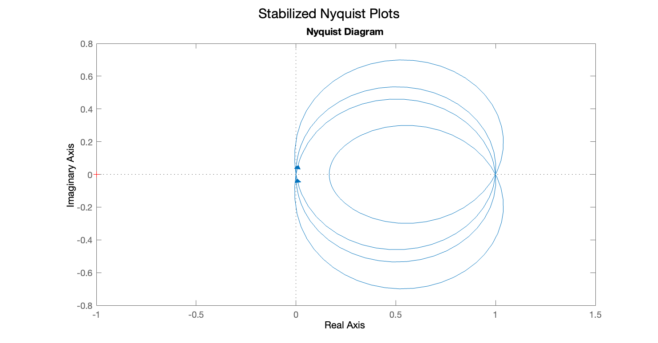
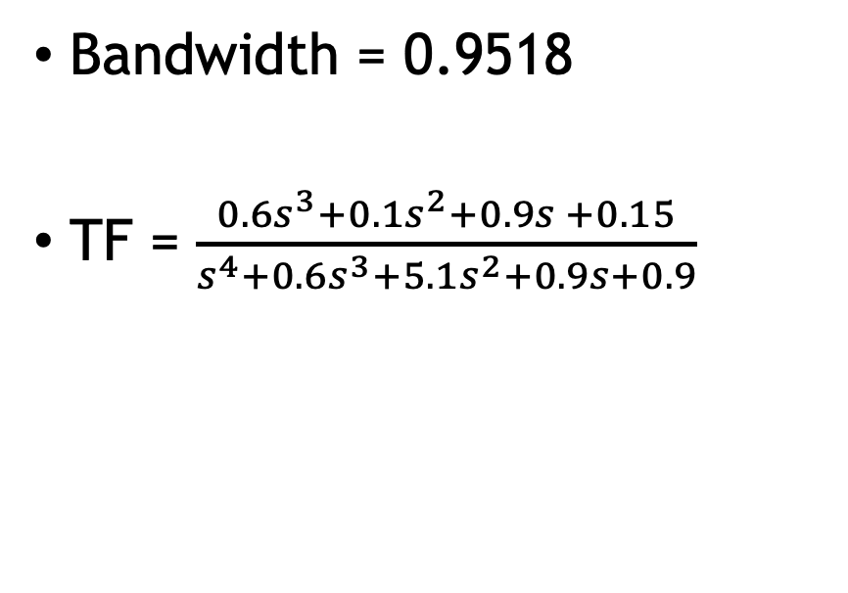
PID Feedback - Nyquist Plot
Bandwidth = 0.9518
TF = $\frac{0.6s^{3}+0.1s^{2}+0.9s +0.15}{s^{4}+0.6s^{3}+5.1s^{2}+0.9s+0.9}$

Slide 14
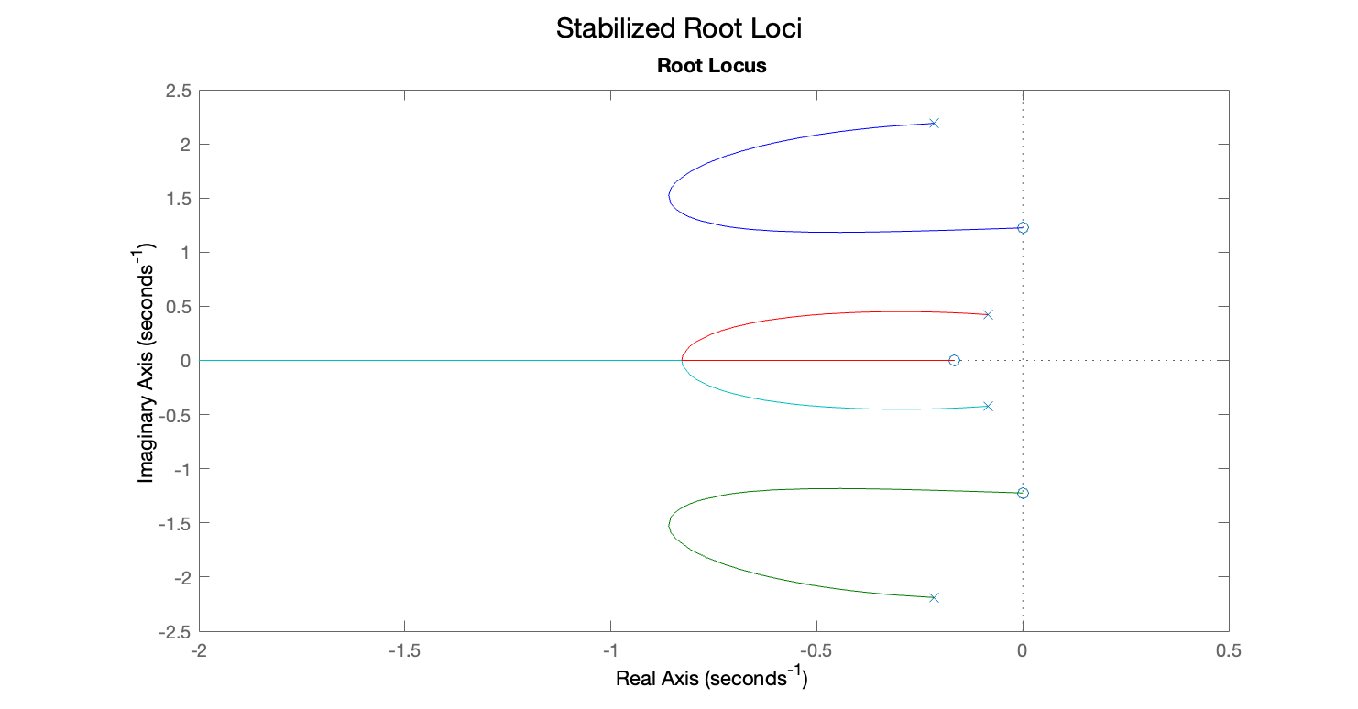
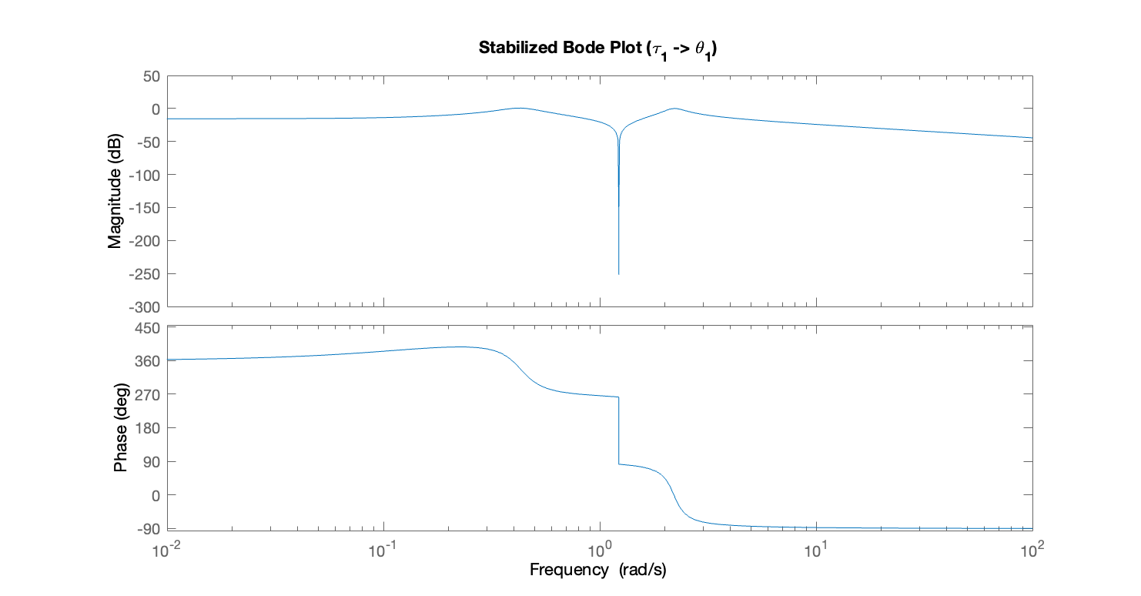
PID Feedback – Root Locus and Bode Plot

Slide 15
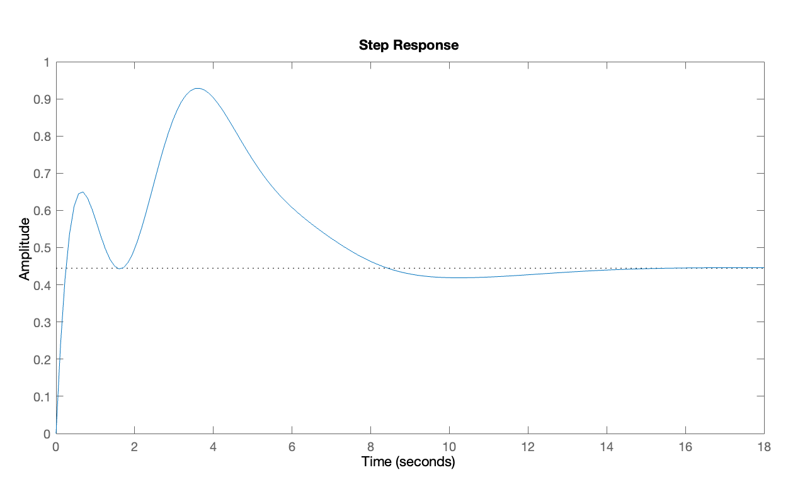
Stabilizing the System using PID
Kp = 1
Ki = 0
Kd = 6
Feedforward Gain = 4
RiseTime: 0.1966
TransientTime: 13.1348
SettlingTime: 13.2605
SettlingMin: 0.4168
SettlingMax: 0.9283
Overshoot: 108.8714
Undershoot: 0
Peak: 0.9283
PeakTime: 3.6569

Slide 16
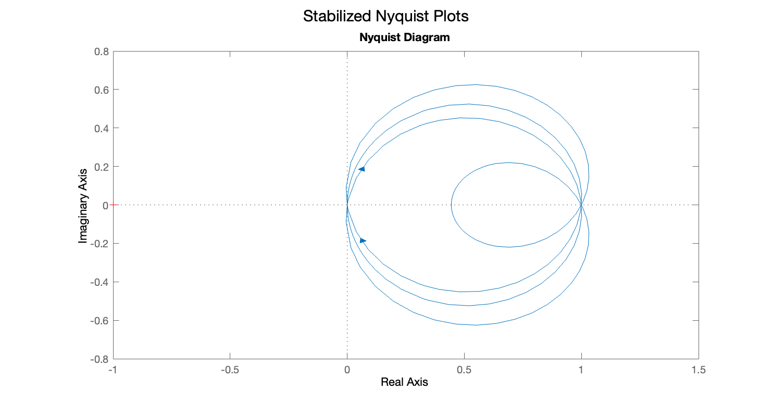
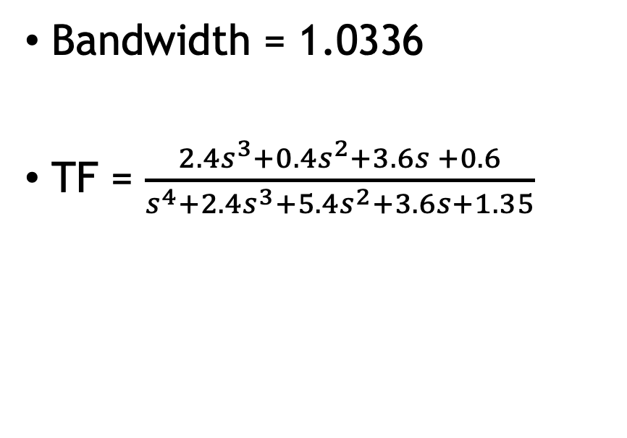
PID Feedback - Nyquist Plot
Bandwidth = 1.0336
TF = $\frac{2.4s^{3}+0.4s^{2}+3.6s +0.6}{s^{4}+2.4s^{3}+5.4s^{2}+3.6s+1.35}$

Slide 17
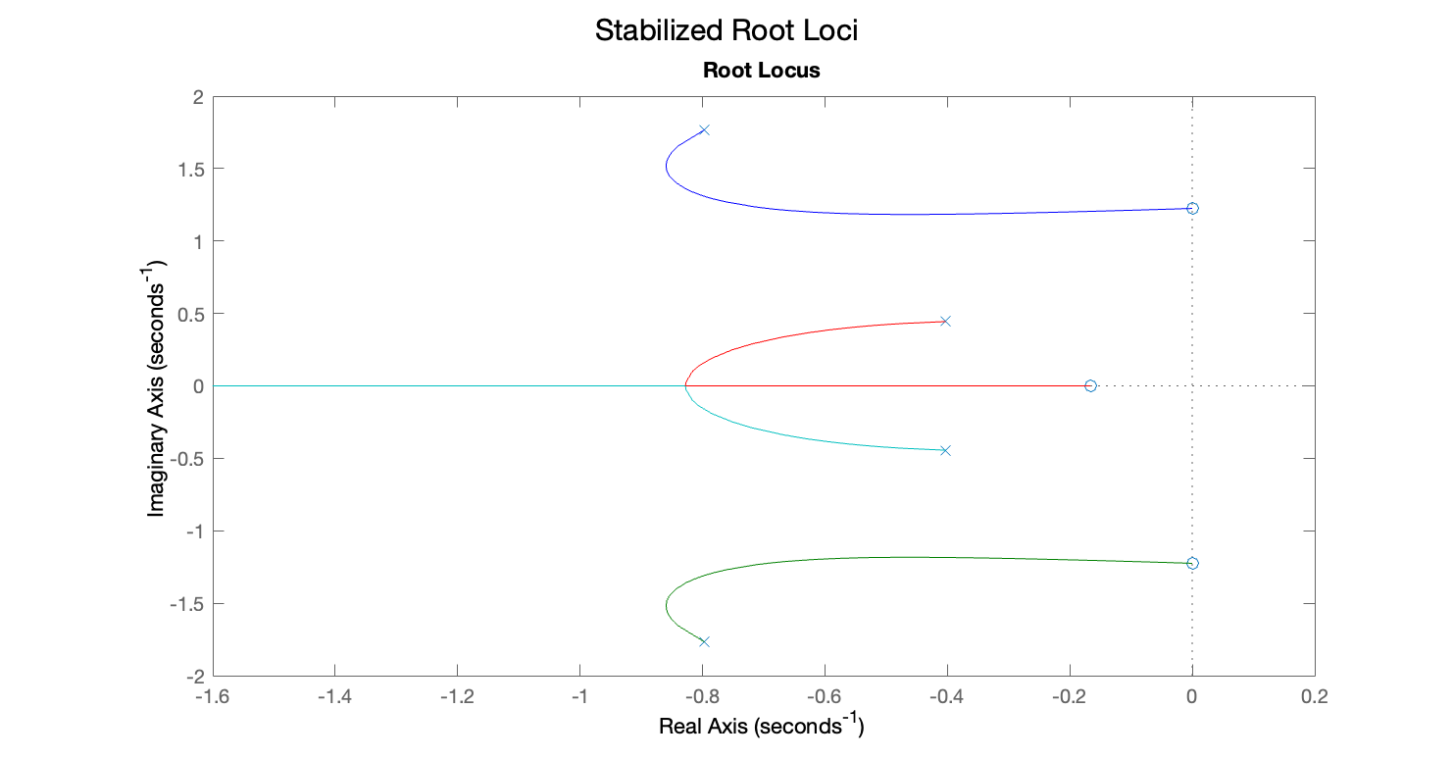
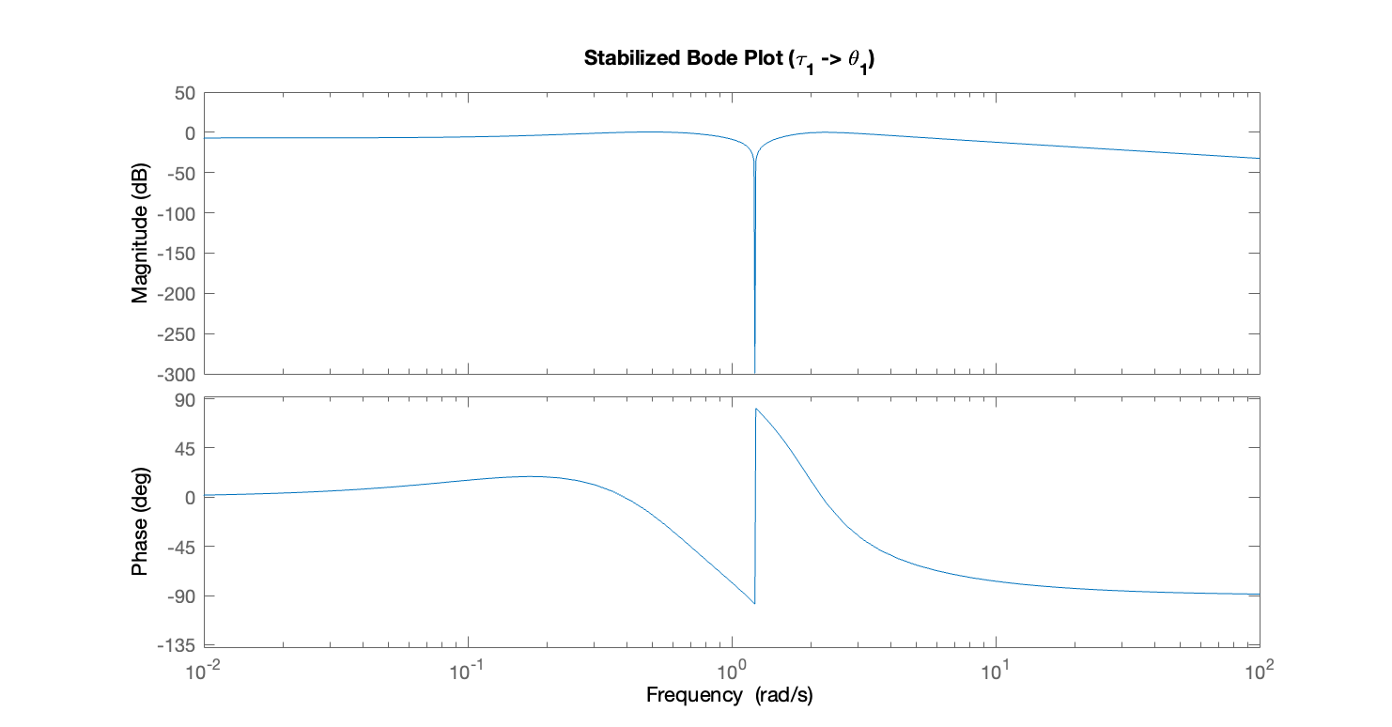
PID Feedback – Root Locus and Bode Plot

Slide 18
Questions?

